Slide 1

ARTROMOT K1
SPARE PARTS
March 2016 sh

Slide 2
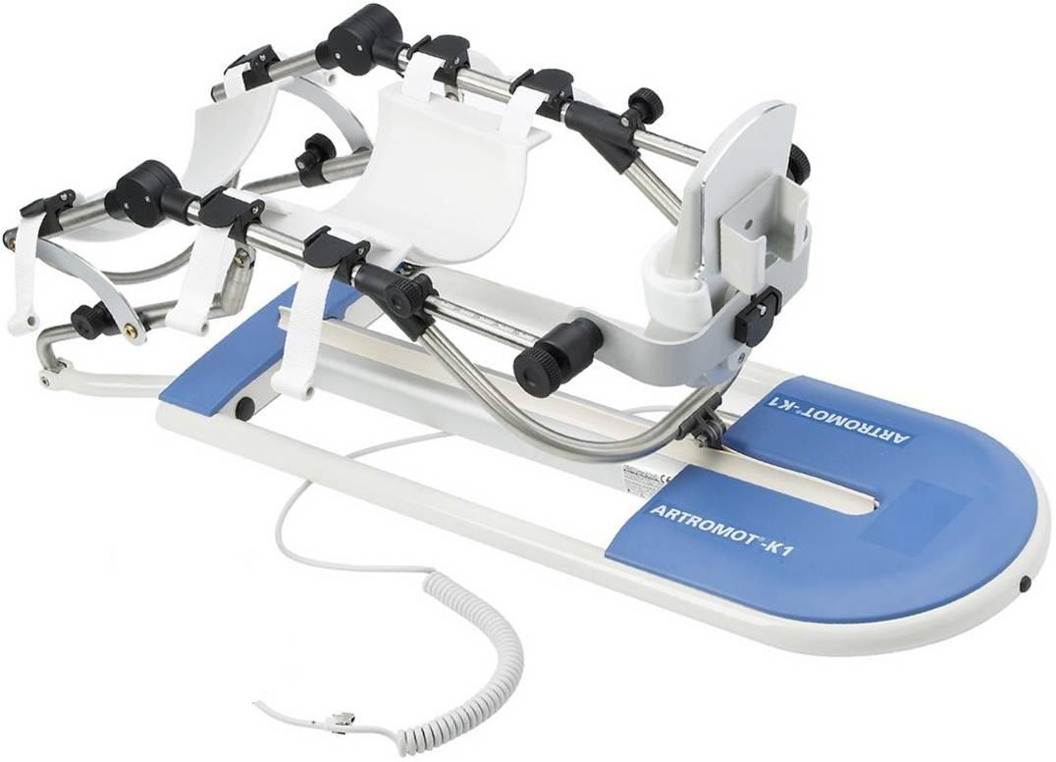
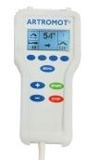
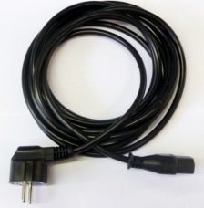
March 2016 sh

Slide 3
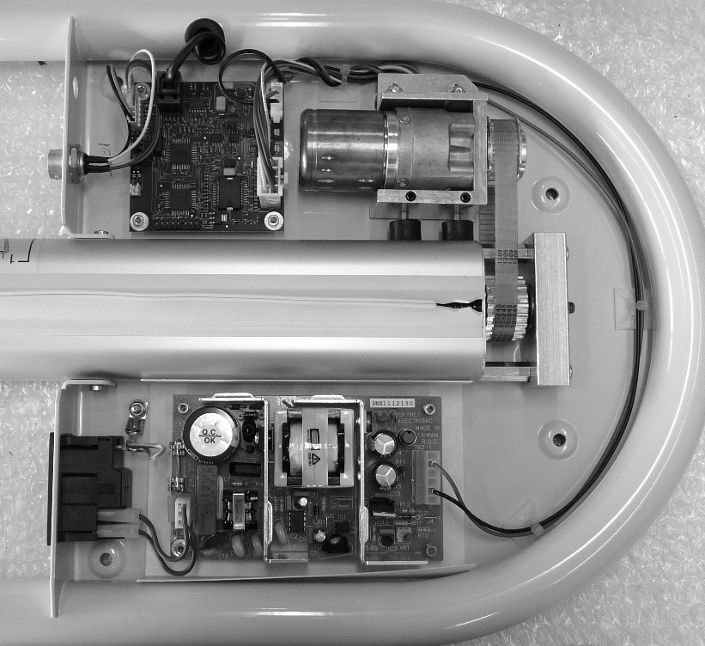
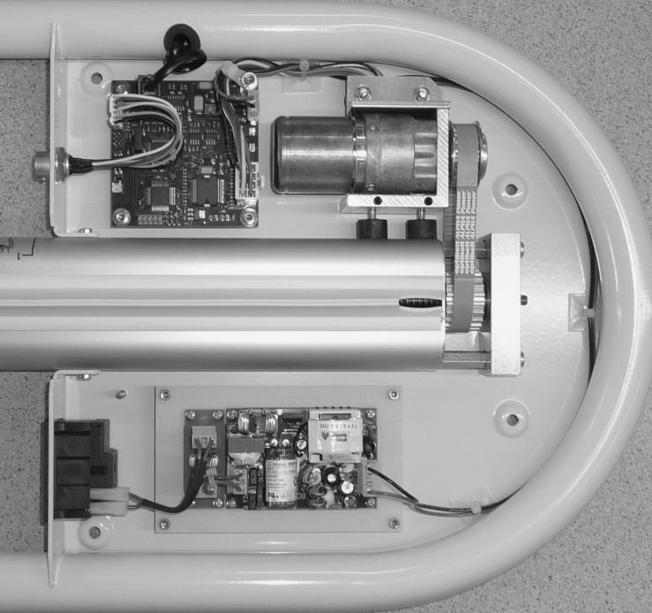
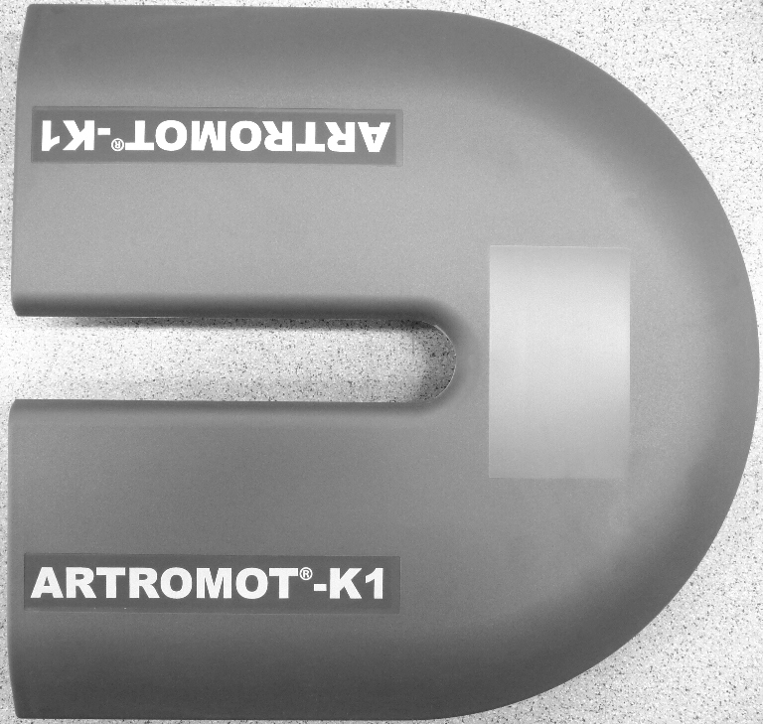
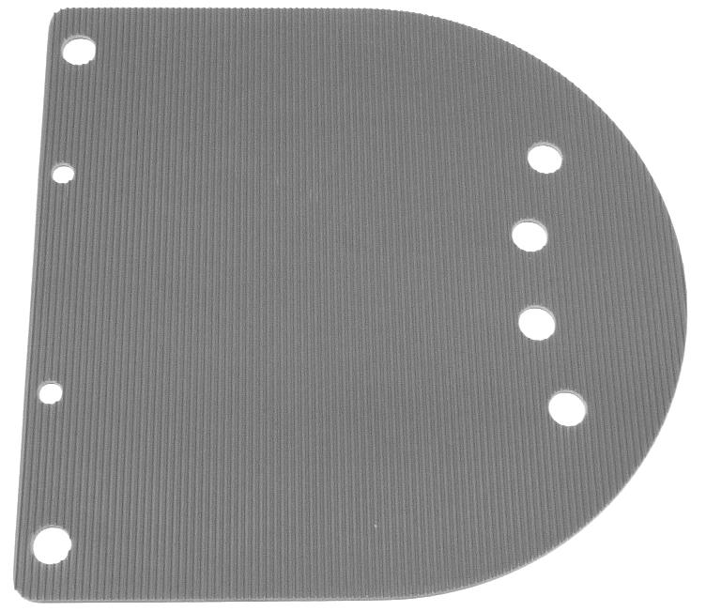
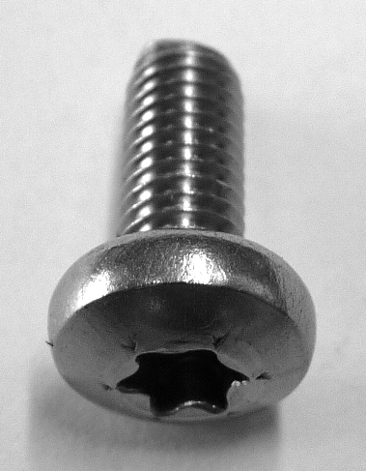
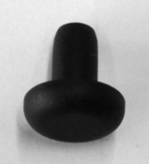
S/N 1000 - 19999
S/N >20000
0.0037.200
DIN7985M5X12A2
2.0037.111
0.0037.115
March 2016 sh

Slide 4
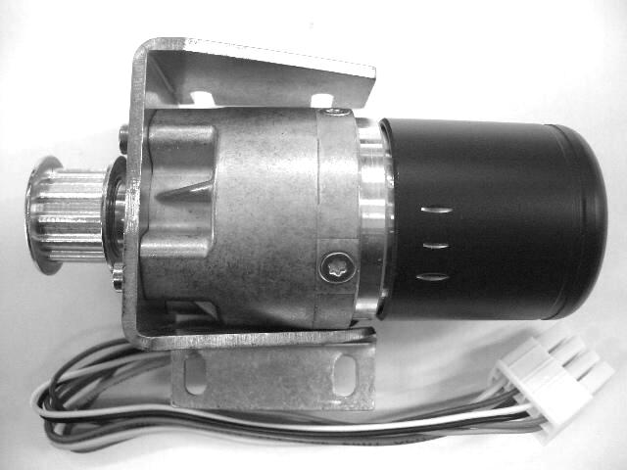
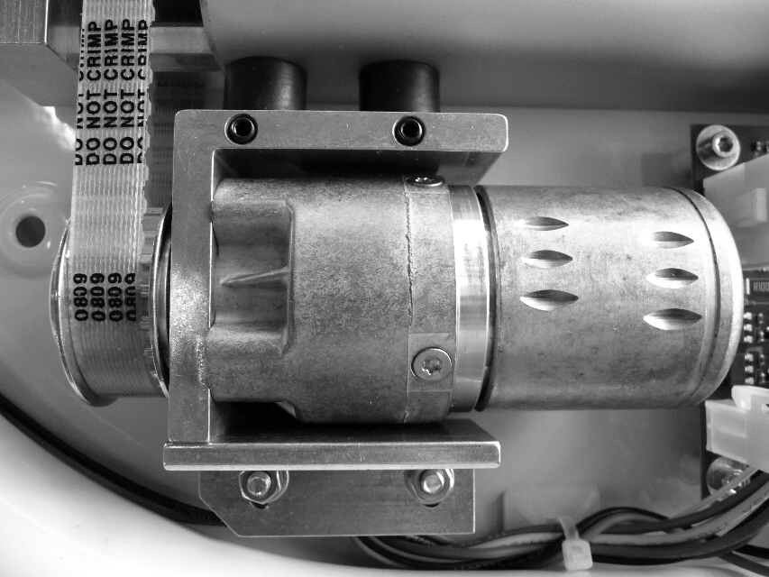
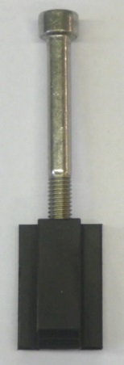
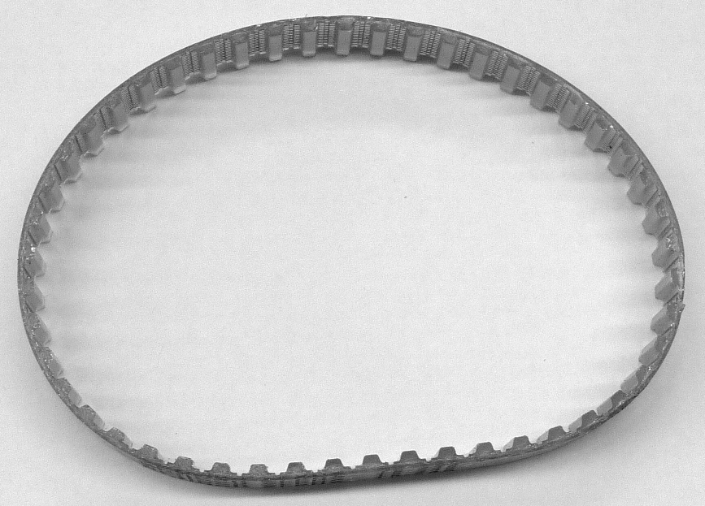
SERIAL NUMBER < 6000
SERIAL NUMBER > 6000
0.0037.075
0.0037.220
0.0037.012
0.0037.105
0.0037.222
March 2016 sh

Slide 5
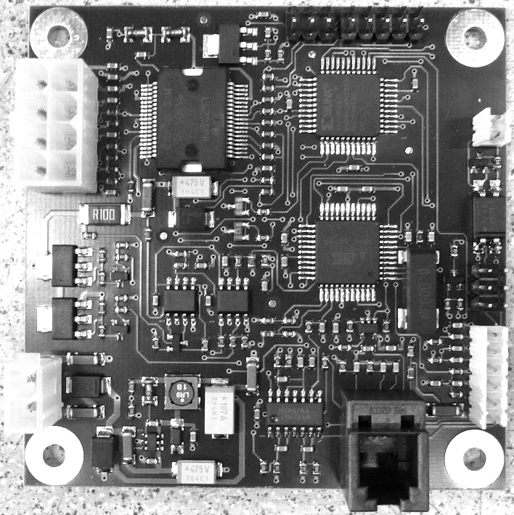
SERIAL NUMBER < 6000
SERIAL NUMBER > 6000
2.0037.901
2.0037.921
March 2016 sh

Slide 6
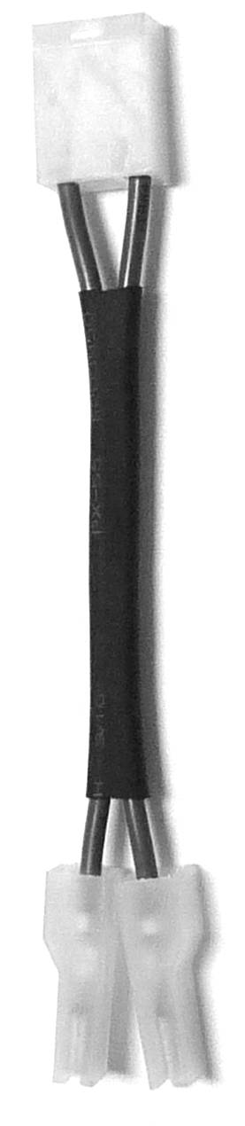
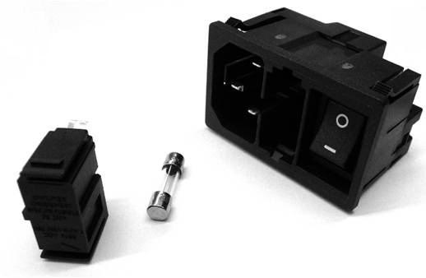
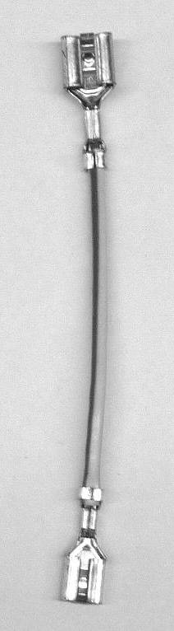
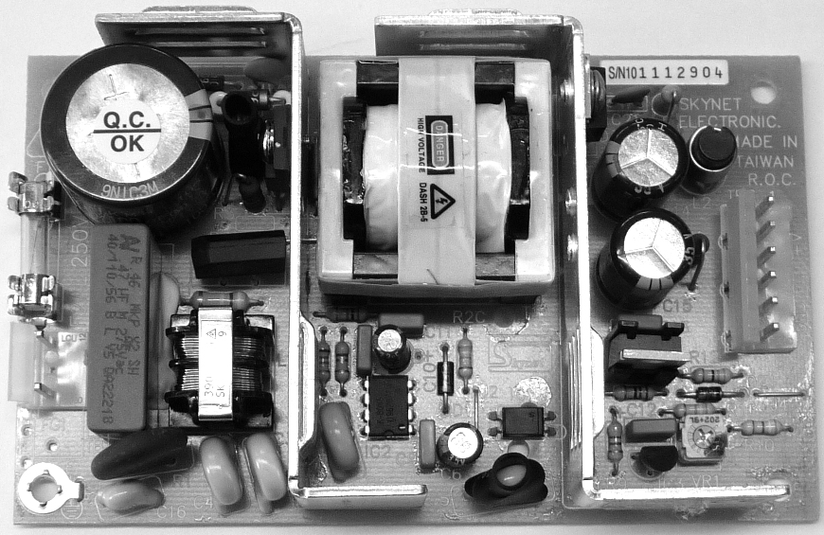
S/N 1000 - 19999
0.0034.246
0.0034.245
2.0034.358
0.0034.244
0.0000.005
2.0034.359
March 2016 sh

Slide 7
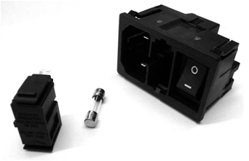

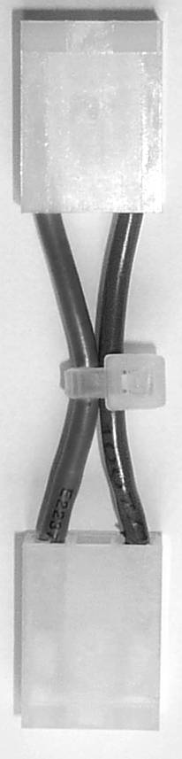
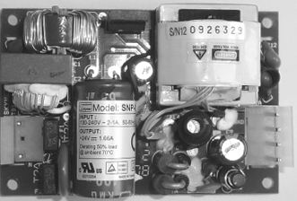

S/N >20000
0.0034.246
0.0034.260
2.0037.913
0.0034.270
0.0000.107
2.0034.359
2.0034.085
2.0034.131
March 2016 sh

Slide 8
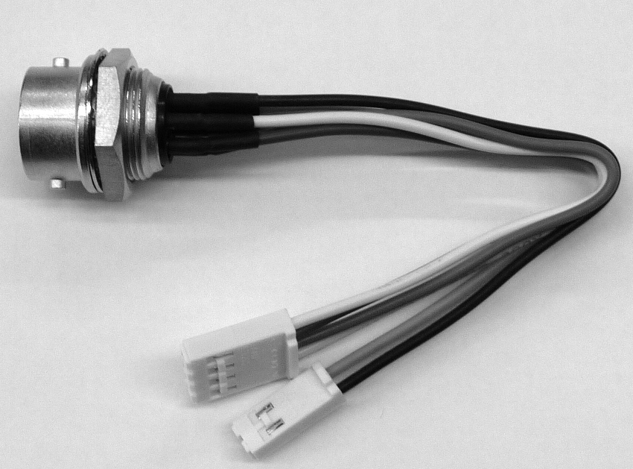
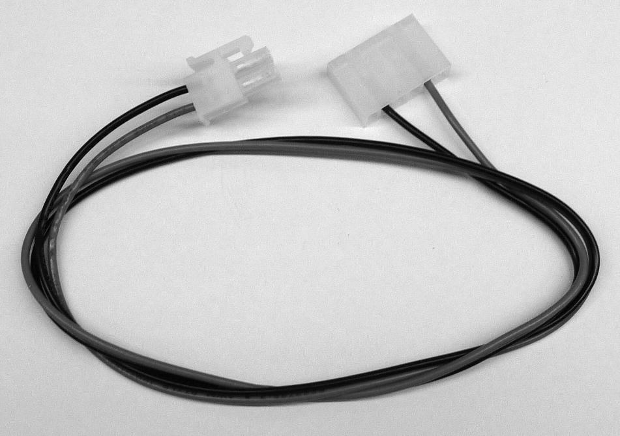
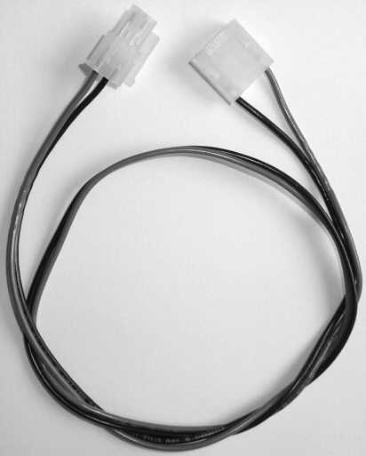
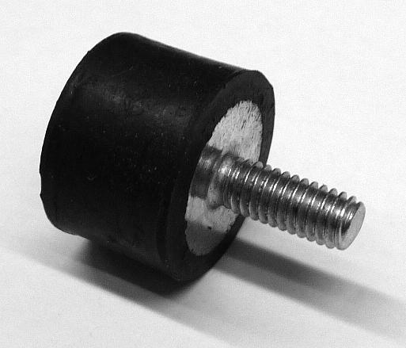
2.0037.004
S/N 1000 – 19999
S/N > 20000
2.0037.005
2.0037.048
0.0037.104
March 2016 sh

Slide 9
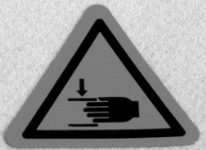
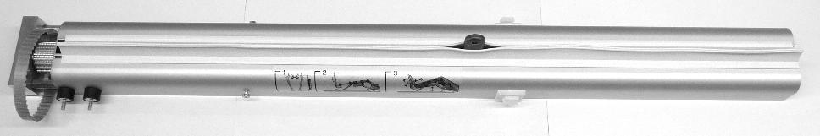

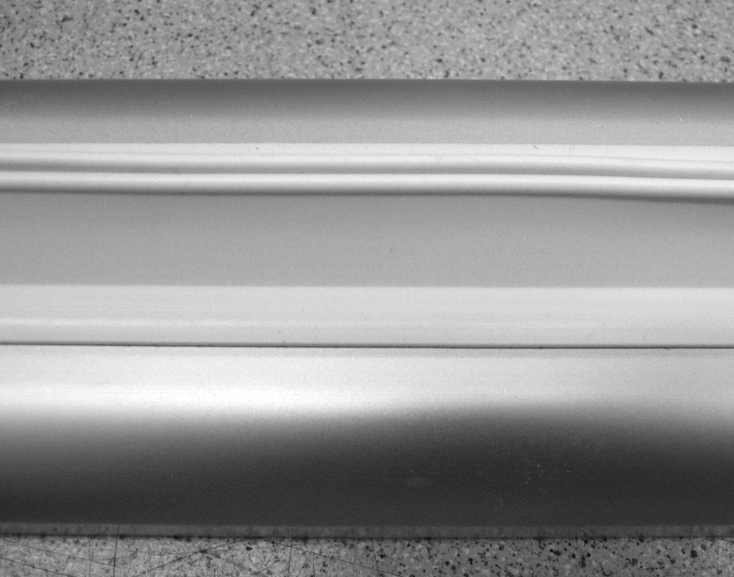
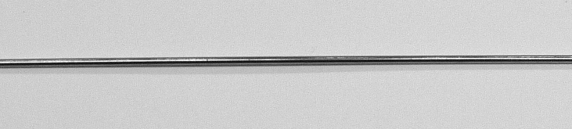
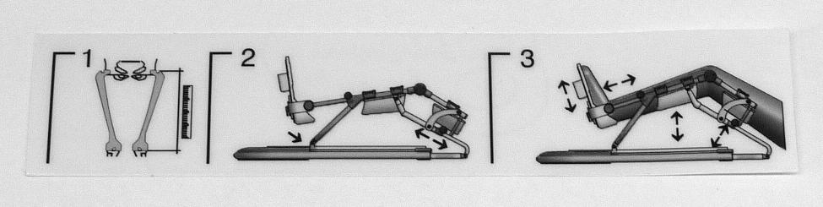
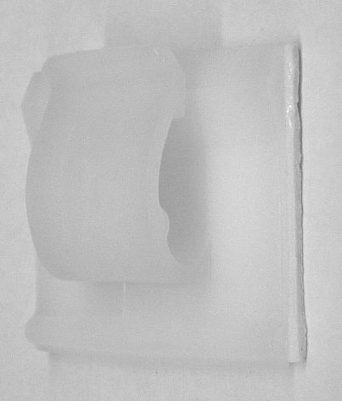
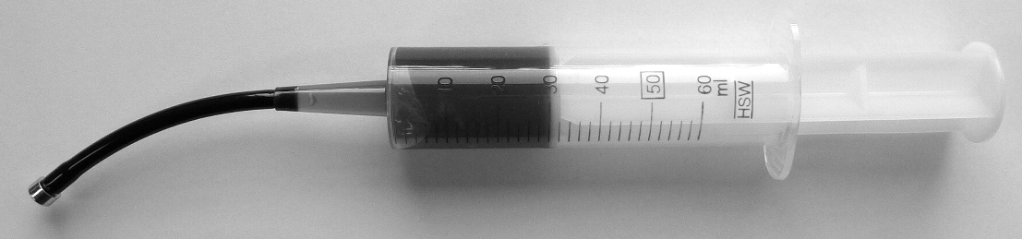
S/N 1000 - 19999
S/N > 20000
0.0037.026
0.0040.025
0.0037.210
0.0037.510
2.0037.105
0.0037.038
2.0037.241
0.0037.039
0.0000.142
March 2016 sh
9

Slide 10
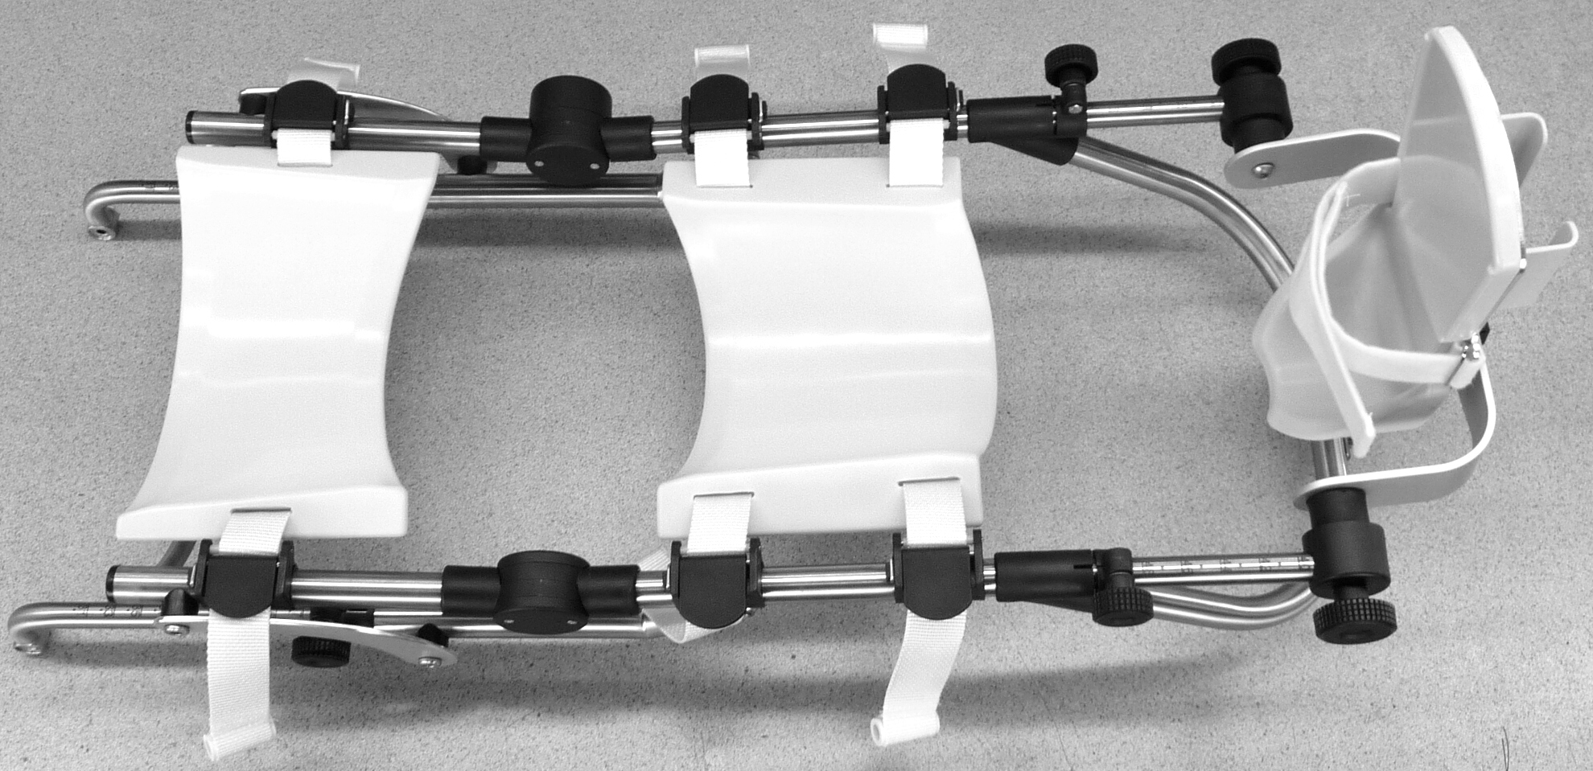
March 2016 sh

Slide 11
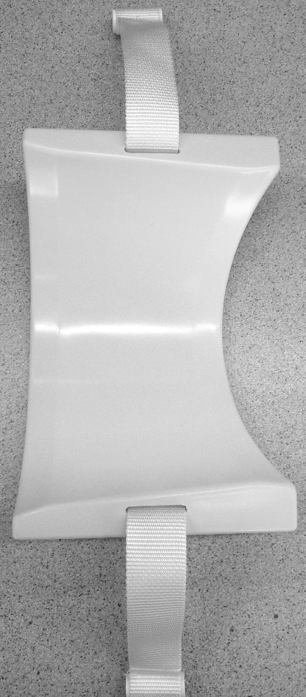
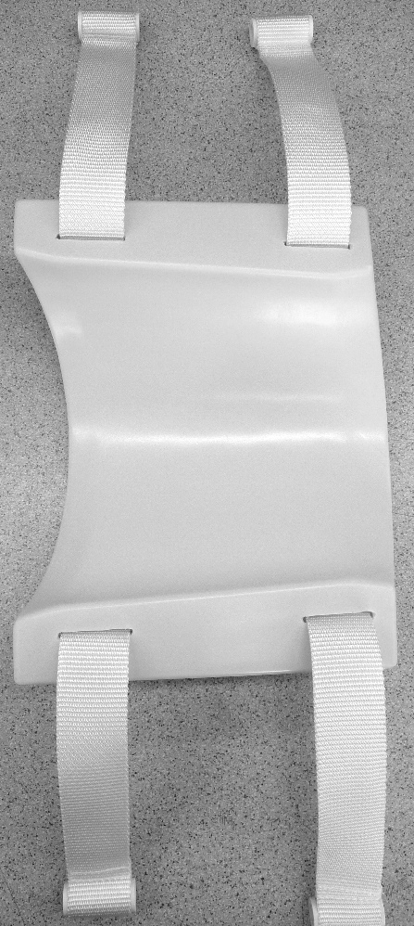
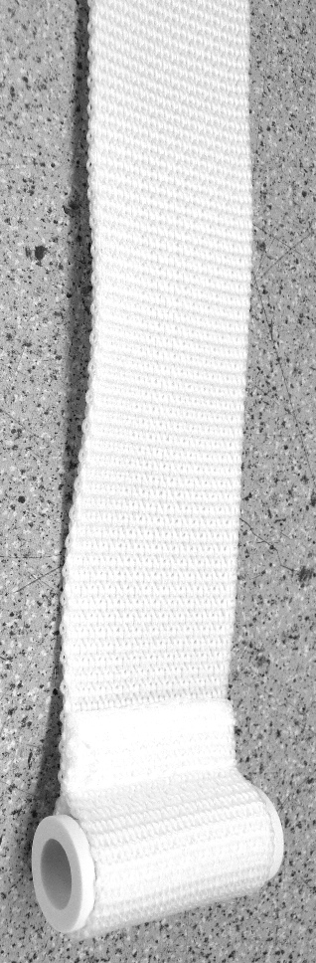
2.0013.073
2.0013.074
2.0013.059
March 2016 sh

Slide 12
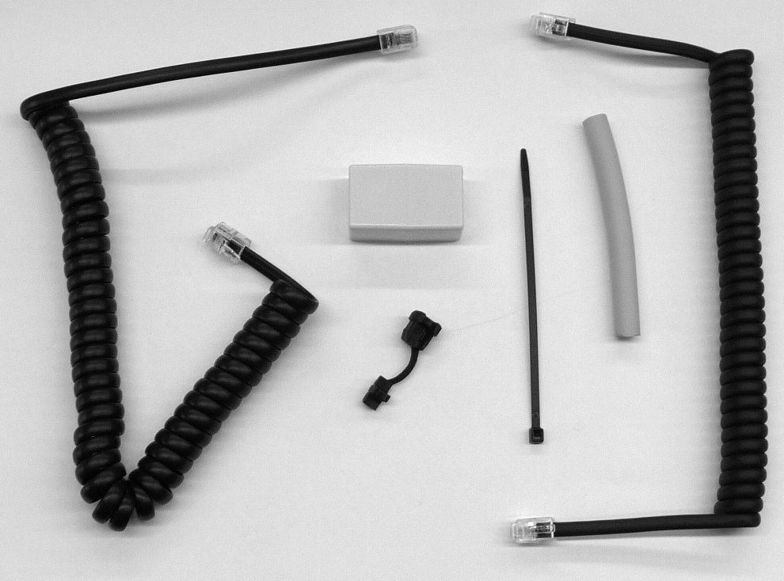
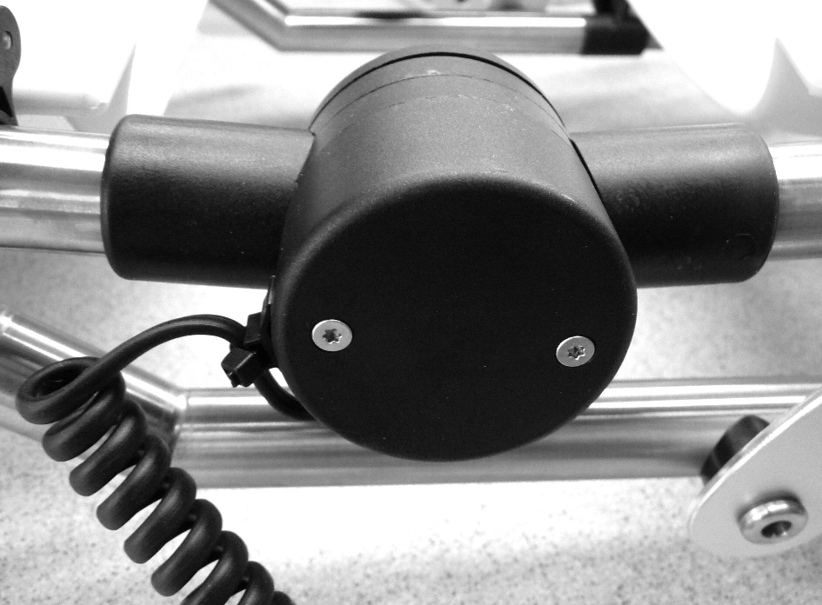
0.0037.082
March 2016 sh

Slide 13
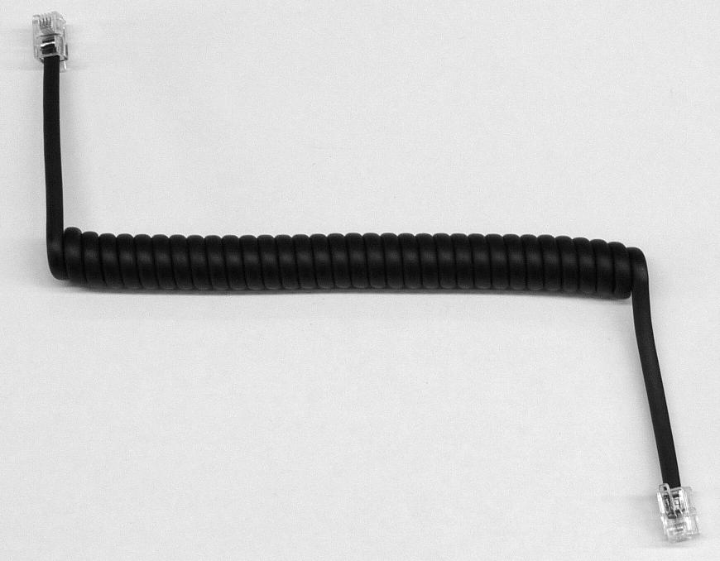
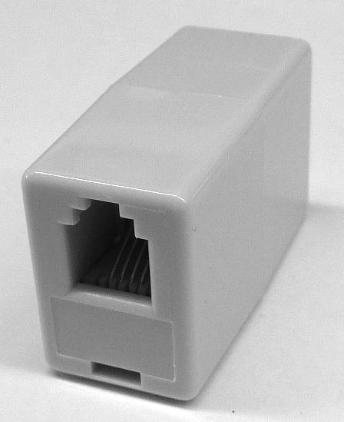
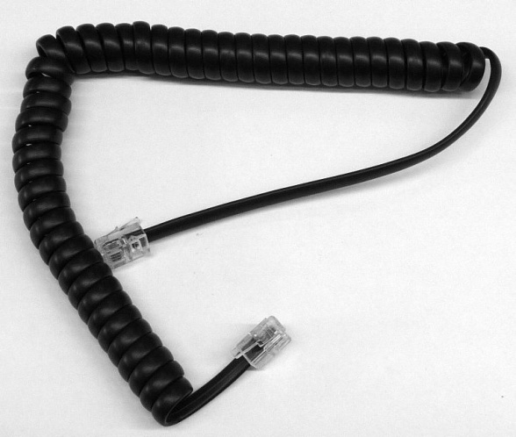
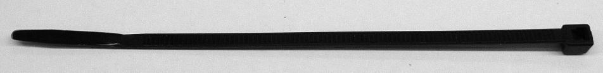
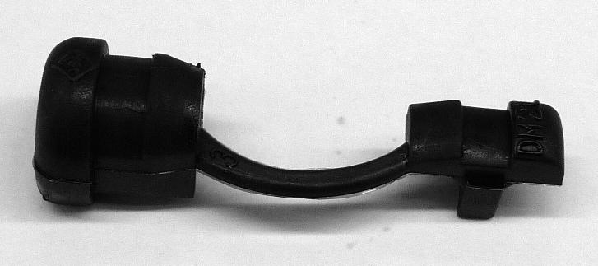
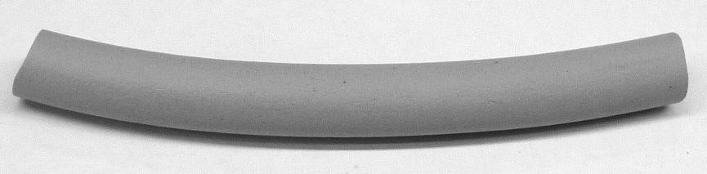
2.0037.258
0.0037.107
0.0031.122
0.0037.111
0.0037.006
2.0013.338
March 2016 sh

Slide 14
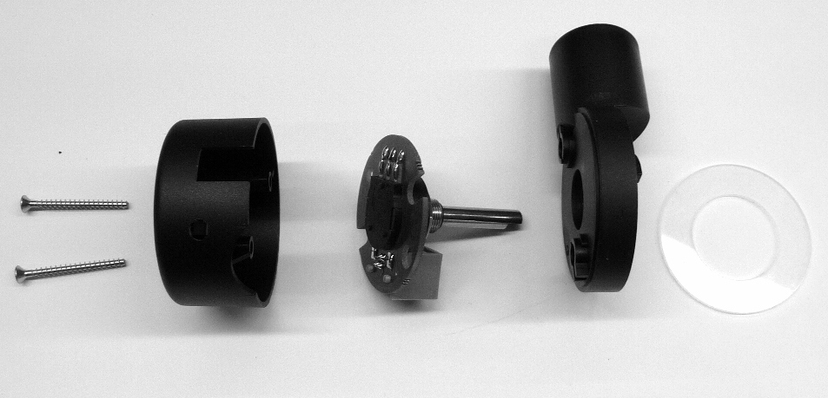
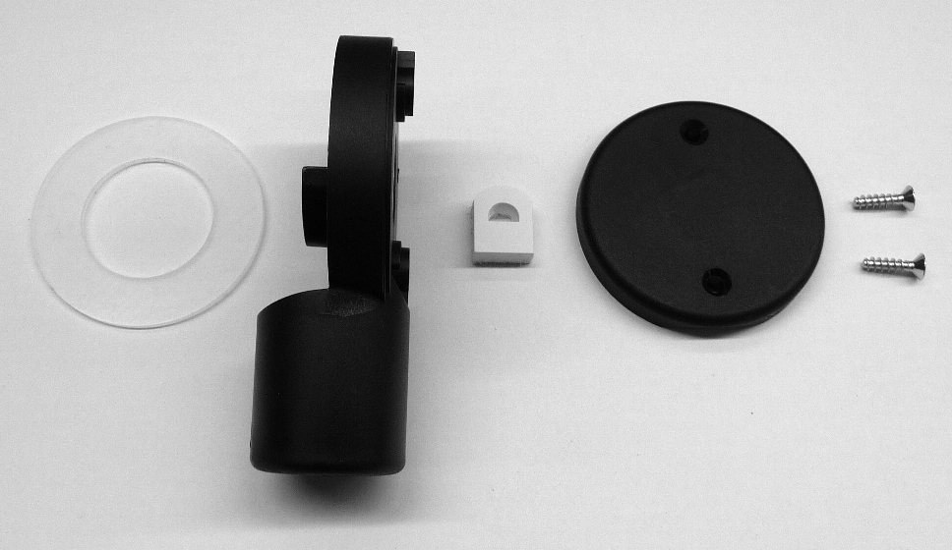
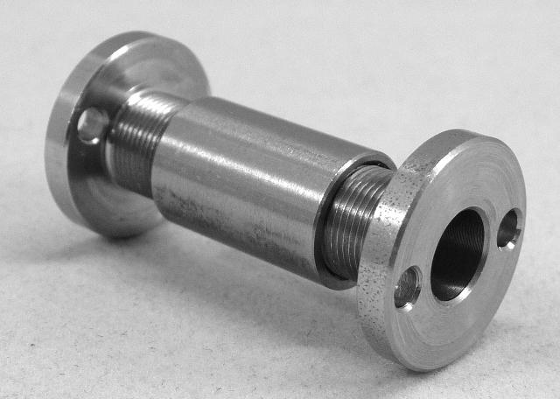
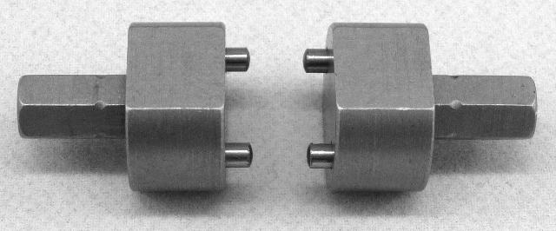
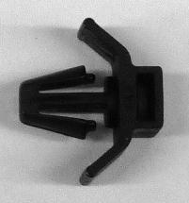
2.0037.152
2.0037.150
2.0037.150
2.0037.151
0.0037.023
2.0037.023
2.0037.136
2.0037.141
0.0037.022
0.0037.110
0.0037.003
0.0037.079
March 2016 sh

Slide 15
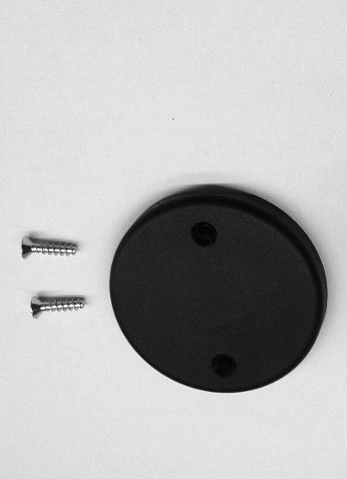



2.0037.151
2.0037.136
2.0037.136
2.0037.151
0.0037.022
2.0037.150
2.0037.150
0.0037.022
0.0037.079
0.0037.003
March 2016 sh

Slide 16







2.0013.087
2.0037.032
DIN6325D3X30
DIN125D5,3vz
DIN7991M5X8A2
2.0037.204
2.0037.205
2.0037.196
2.0037.190
2.0013.301
2.0038.012
0.0037.077
0.0037.076
2.0013.303
2.0013.298
DIN7991M5X18A2
March 2016 sh
16
16

Slide 17



2.0037.195
GN534-40-M8SW
0.0037.078
0.0037.202
2.0031.119
0.0034.118
2.0037.153
March 2016 sh

Slide 18


0.0037.150
2.0037.243
2.0013.314
2.0037.202
March 2016 sh

Slide 19

0.0037.150
2.0037.243
2.0013.314
2.0037.203
March 2016 sh

Slide 20




0.0037.201
0.0037.207
2.0037.121
DIN7985M5X12A2
0.0037.017
March 2016 sh

Slide 21

March 2016 sh

Slide 22







LEFT: 0.0037.128; RIGHT: 0.0037.129
2.0037.047
2.0037.173
DIN6799D5A2
S/N < 13000
S/N ≥ 13000
0.0037.018
0.0037.078
0.0040.005
2.0037.118
2.0037.139
2.0037.162
March 2016 sh

Slide 23





2.0037.137
959.026
2.0037.009
0.0037.037
0.0037.025
March 2016 sh

Slide 24



STANDARD 0.0037.050
STANDARD + CHIPCARD 0.0037.051
COMFORT 0.0037.054
COMFORT + CHIPCARD 0.0037.055
CLASSIC 0.0037.061
0.0037.103
March 2016 sh

Slide 25










0.0000.210
0.0037.014
0.0037.043
0.0034.048
0.0037.101
2.0037.169
2.0037.035
0.0031.004
0.0037.100
0.0037.102
March 2016 sh

Slide 26







2.0037.208
0.0037.089
2.0037.908
0.0037.044
958.007
2.0037.215
2.0037.035
0.0031.004
2.0037.209
0.0037.102
March 2016 sh

