Slide 1
ARTROMOT-SP3
SPARE PARTS

Slide 2
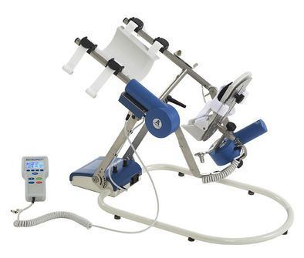

Slide 3
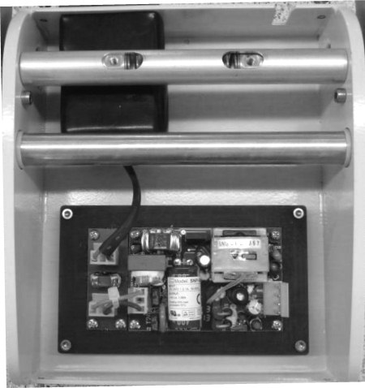
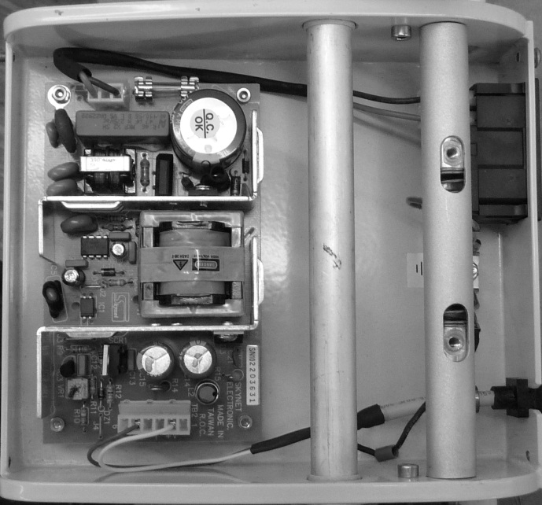
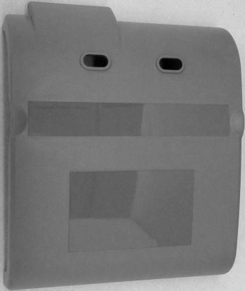
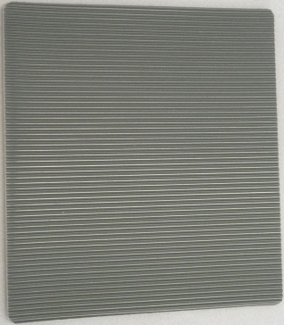

S/N 1000 - 19999
S/N > 20000
2.0038.104
2.0038.105
2.0038.151

Slide 4

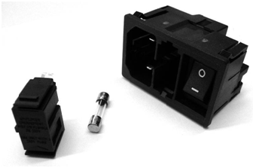
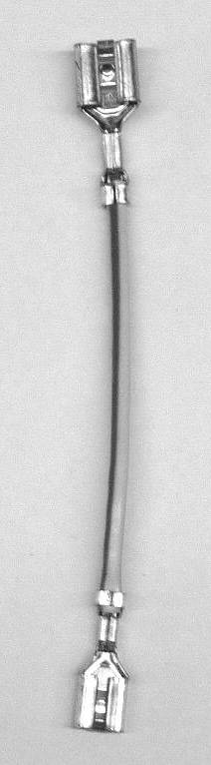
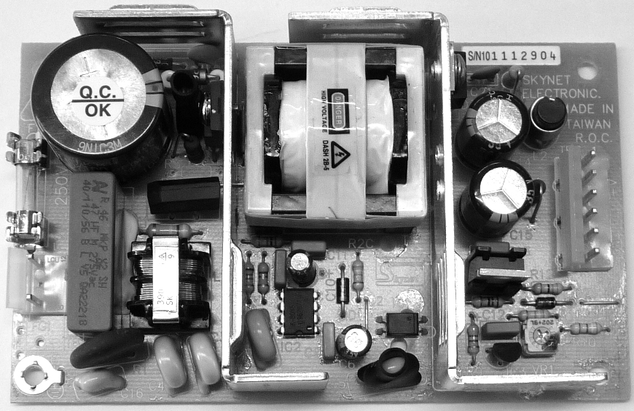
S/N 1000 - 19999
0.0034.246
0.0034.245
2.0034.358
0.0034.244
0.0000.005
2.0038.017

Slide 5
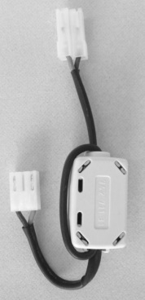

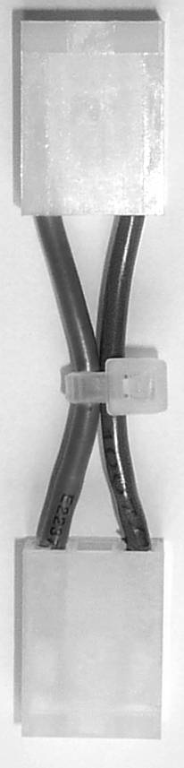
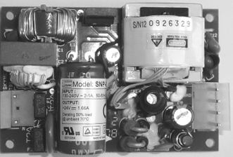
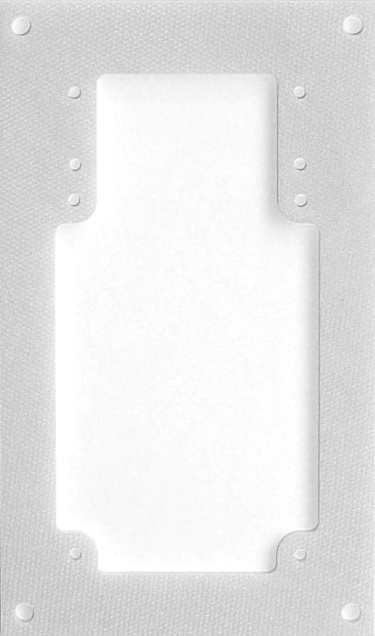
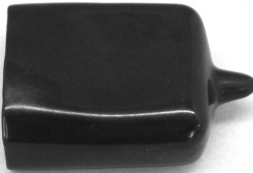
S/N >20000
0.0034.246
0.0034.260
2.0037.913
0.0034.270
0.0000.107
2.0038.034
2.0034.085
2.0034.131
0.0034.261

Slide 6
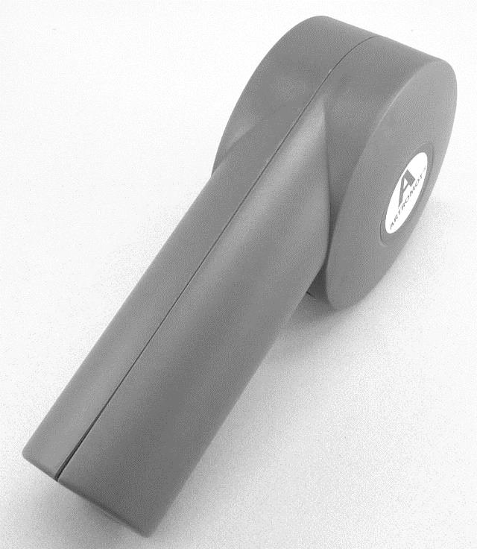
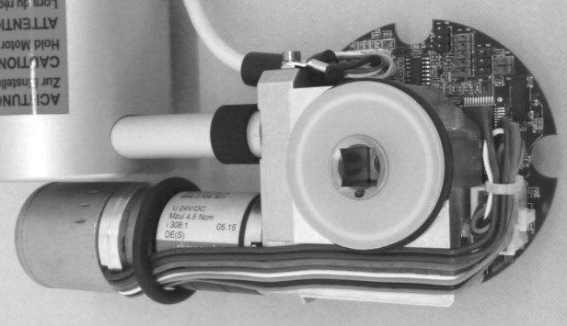

Slide 7
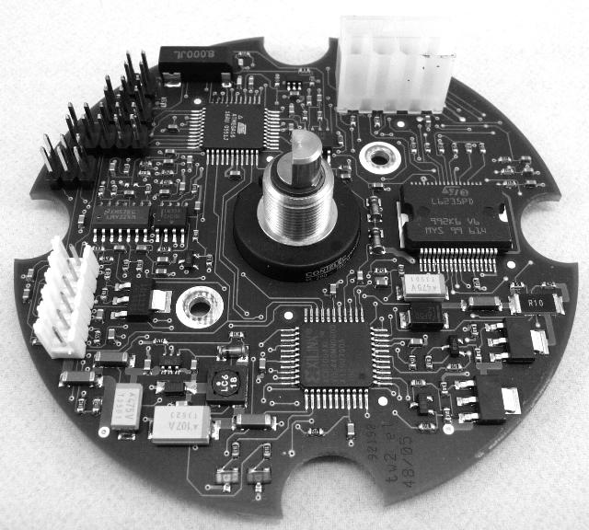
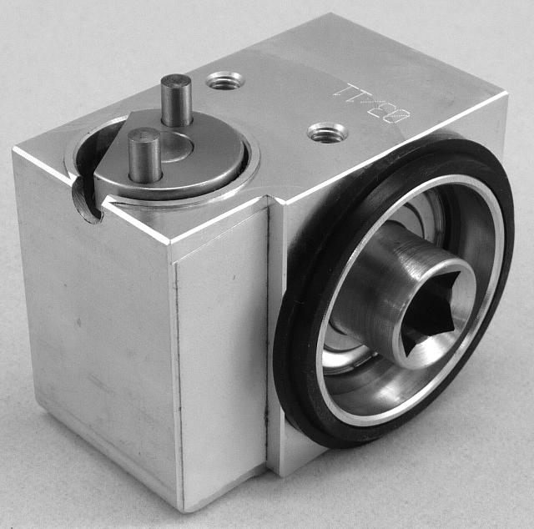
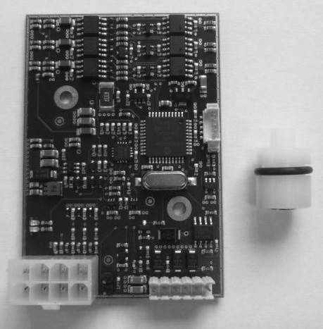
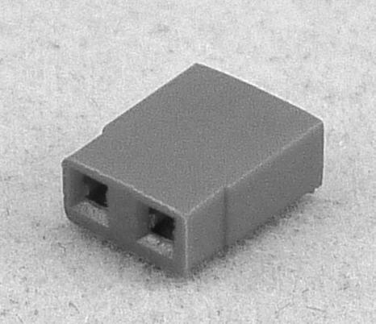
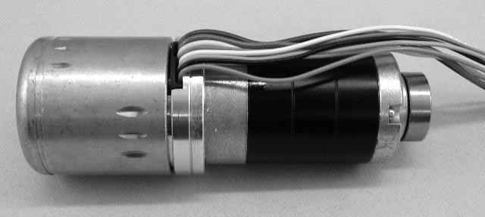

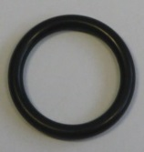

GEAR MOTOR A
0.0034.203
2.0038.901
NEW
GEAR MOTOR B
0.0038.106
2.0038.014
MOTOR A
0.0034.068
0.0034.112
0.0034.138

Slide 8
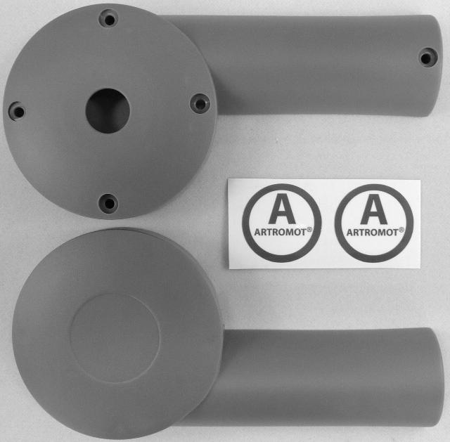
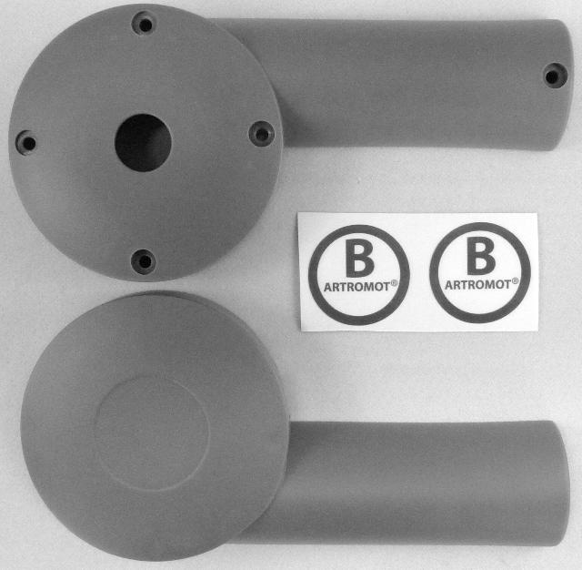
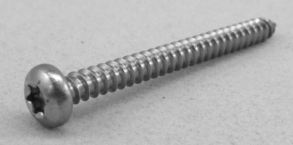
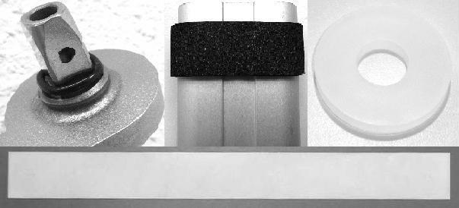


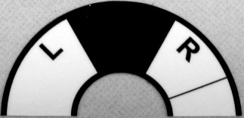
0.0034.400
0.0034.401
0.0034.020
2.0034.267
2.0034.271
2.0038.146
0.0034.403

Slide 9
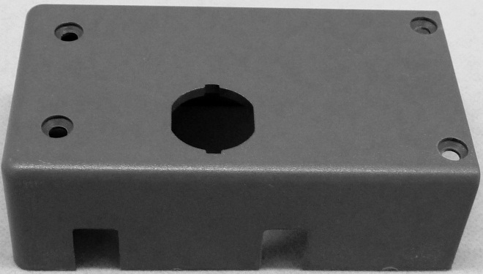
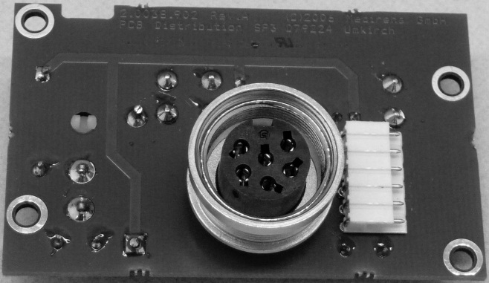
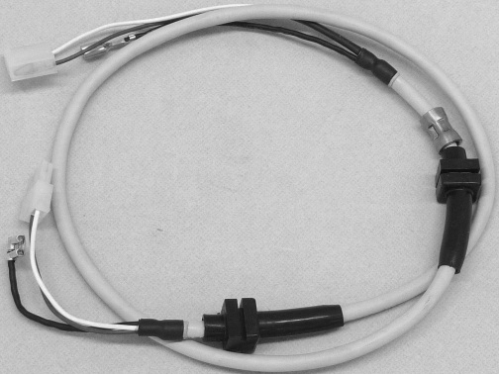
2.0038.109
2.0038.902
2.0038.032

Slide 10
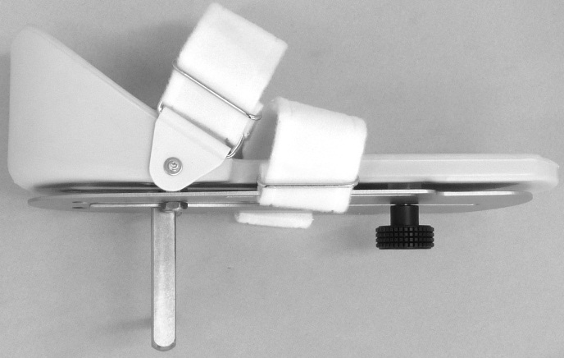
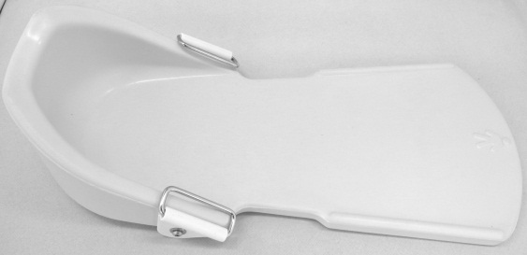
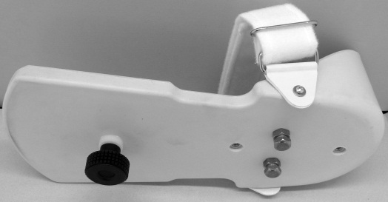
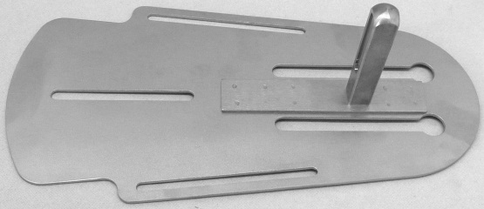
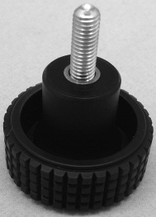
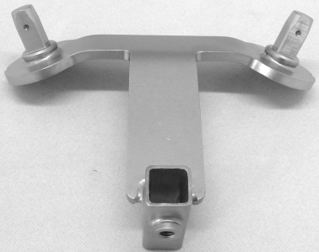
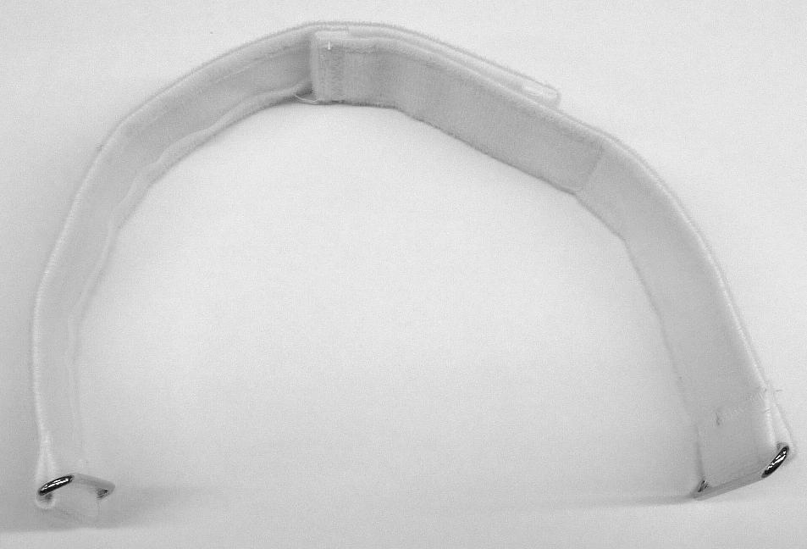
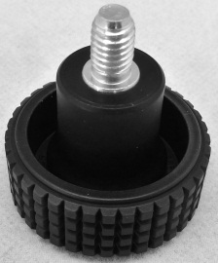
0.0038.064
2.0040.019
0.0038.063
0.0038.060
2.0038.004
GN534-32-M6-10
2.0038.022
2.0013.087

Slide 11
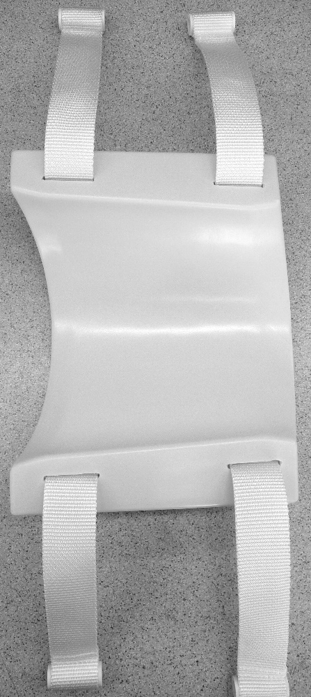
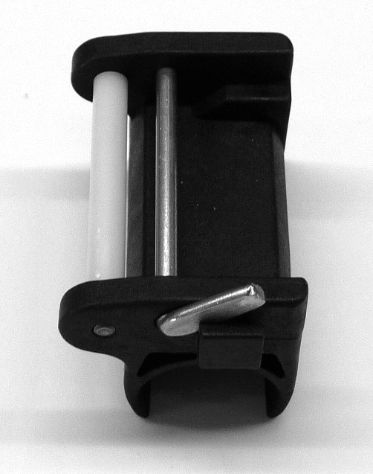
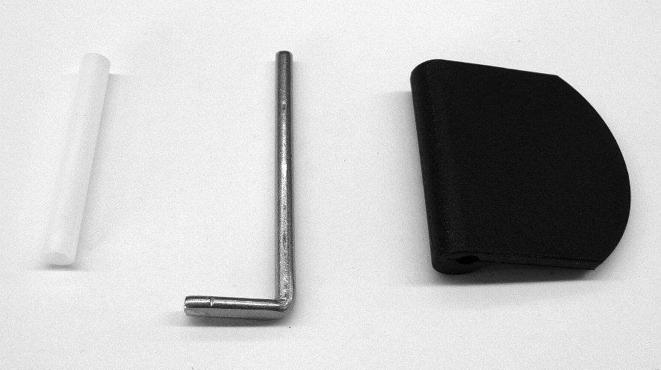
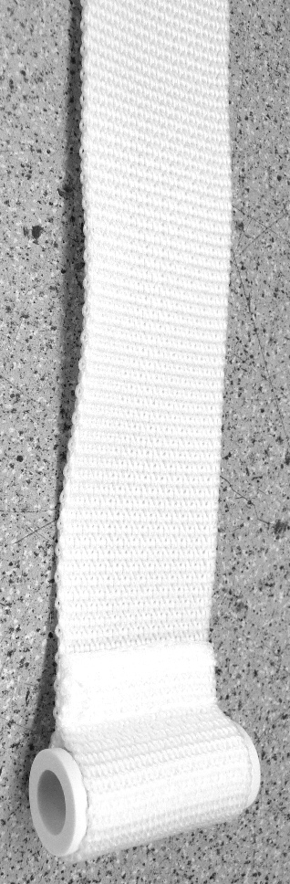
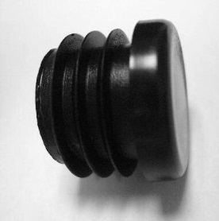
2.0013.074
0.0037.150
2.0037.243
2.0013.059
2.0013.314
2.0037.203
959.026

Slide 12
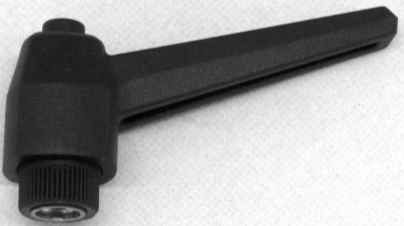
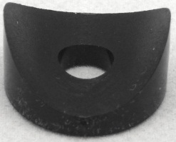
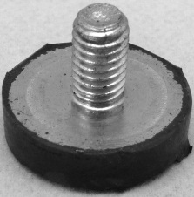
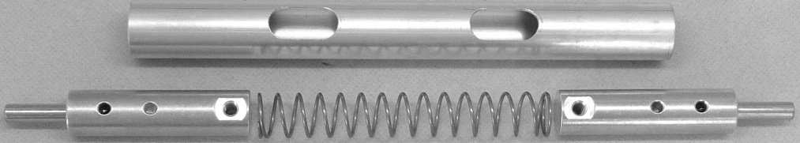
GN503-63-M8-sw
0.0038.011
0.0038.012
2.0038.130
0.0038.030
960.053
0.0038.030

Slide 13
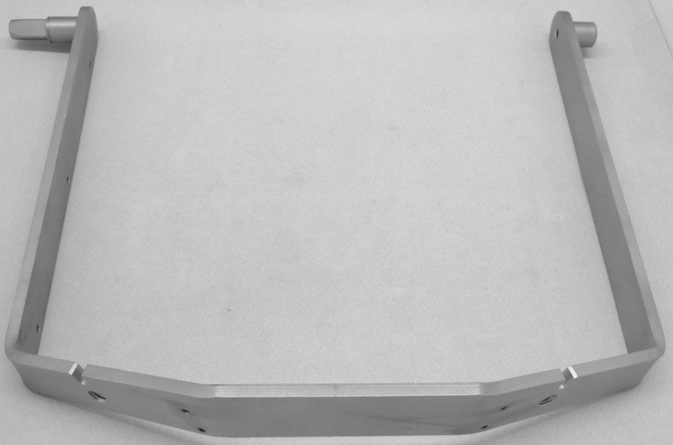
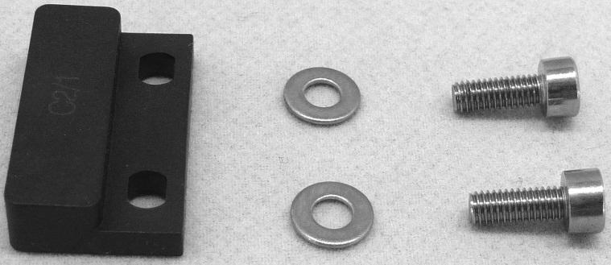
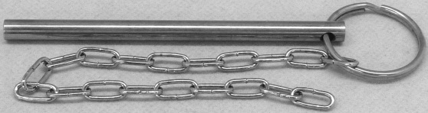
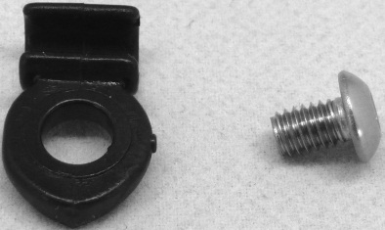
2.0038.008
0.0038.010
DIN912M3x8A2
DIN125D3,2A2
0.0038.003
LIKOM4x6A2
401.218

Slide 14



0.0038.061
2.0038.005
2.0038.015
0.0034.007

Slide 15



0.0034.048
0.0037.103
STANDARD 0.0038.050
STANDARD + CHIPCARD 0.0038.051
COMFORT 0.0038.052
COMFORT + CHIPCARD 0.0038.053

Slide 16









0.0000.210
0.0037.014
0.0037.043
0.0037.101
2.0038.018
2.0037.169
0.0031.004
0.0037.100
0.0037.102

