Slide 1

ARTROMOT Active-K
SPARE PARTS
September 2016 sh

Slide 2
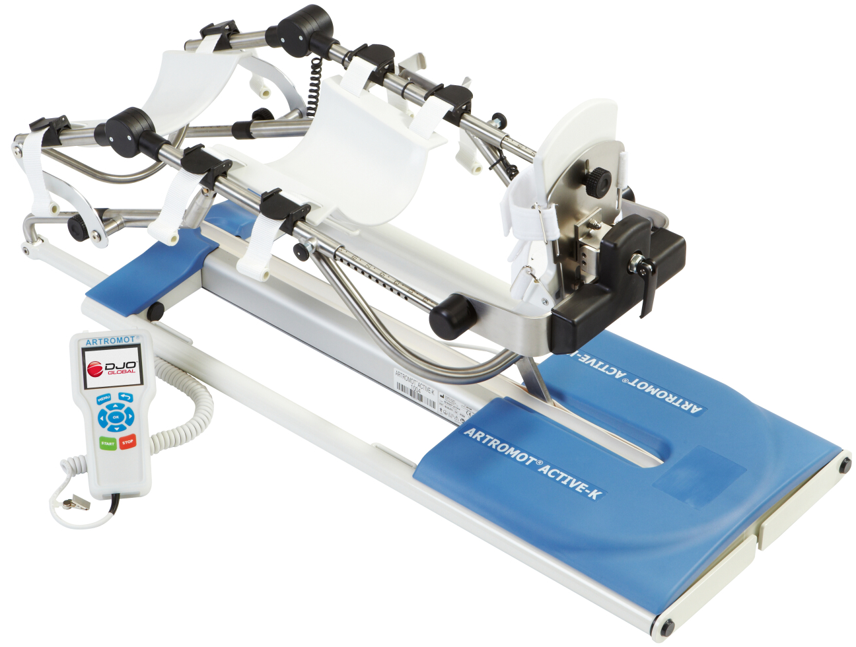




September 2016 sh

Slide 3
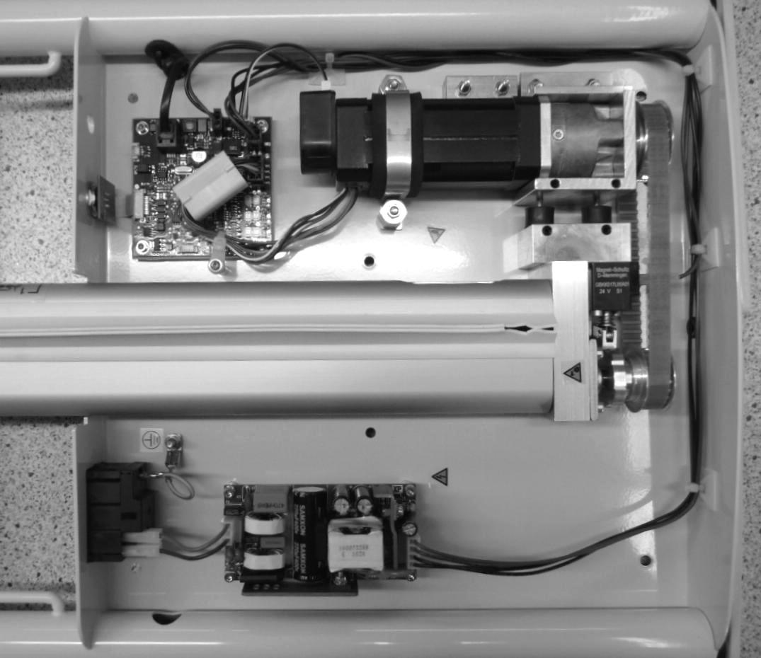
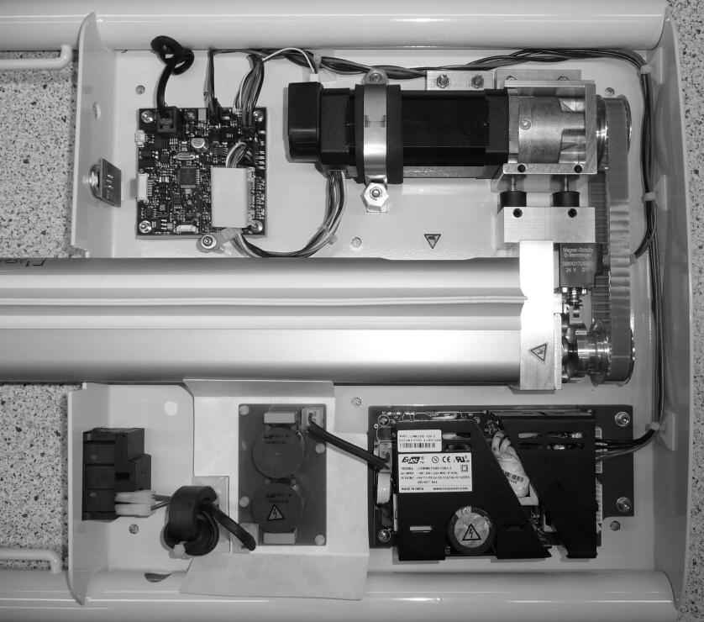
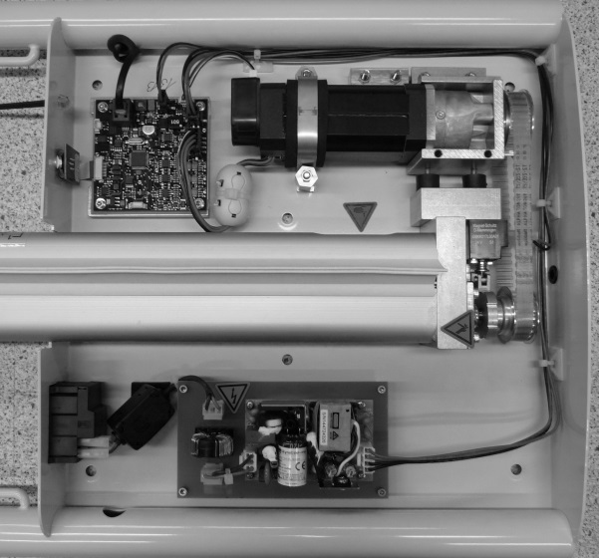
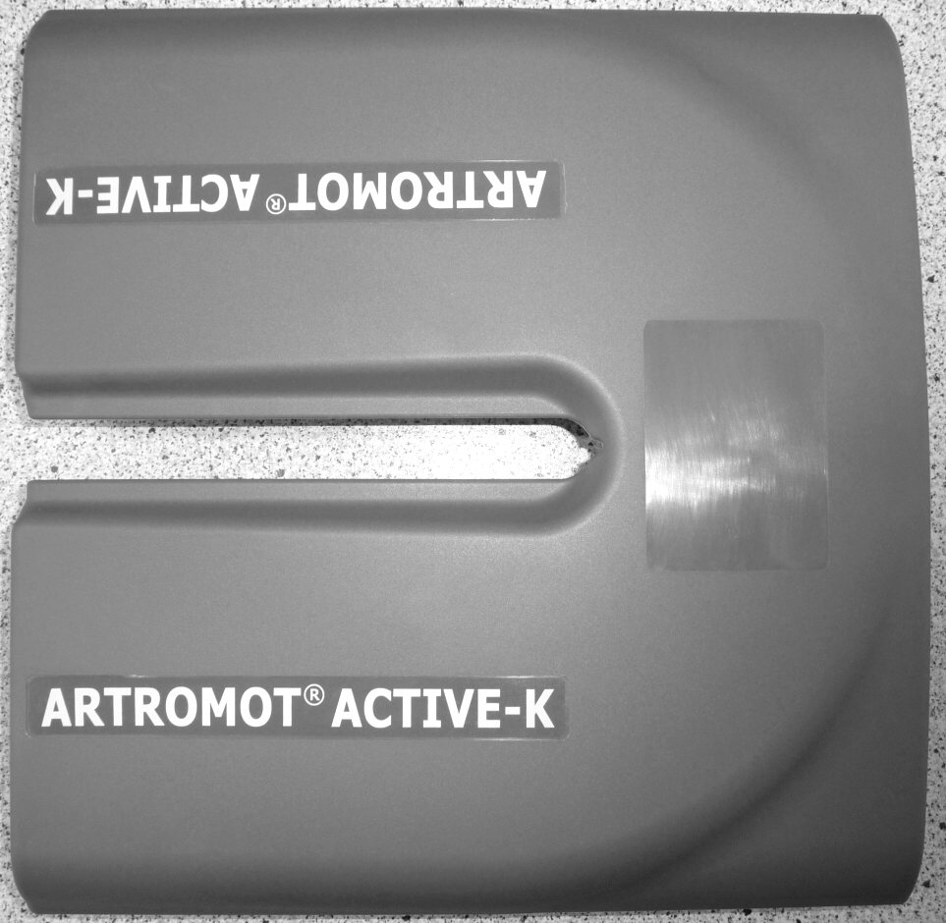
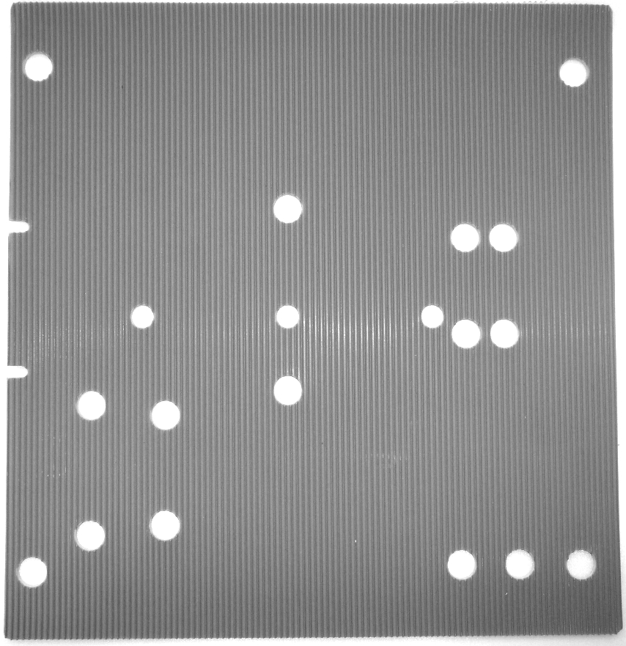
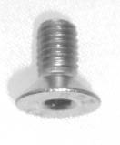
S/N 1000- 1999
S/N 2000 - 3999
S/N > 4000
DIN7991M5X10A2
2.0040.140
0.0040.330
September 2016 sh

Slide 4
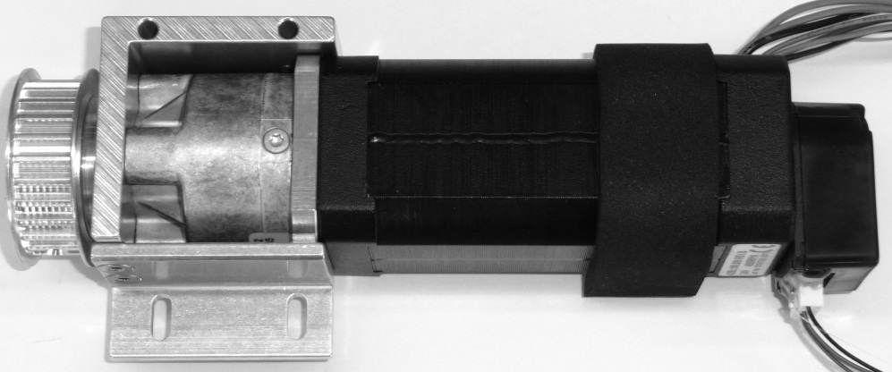
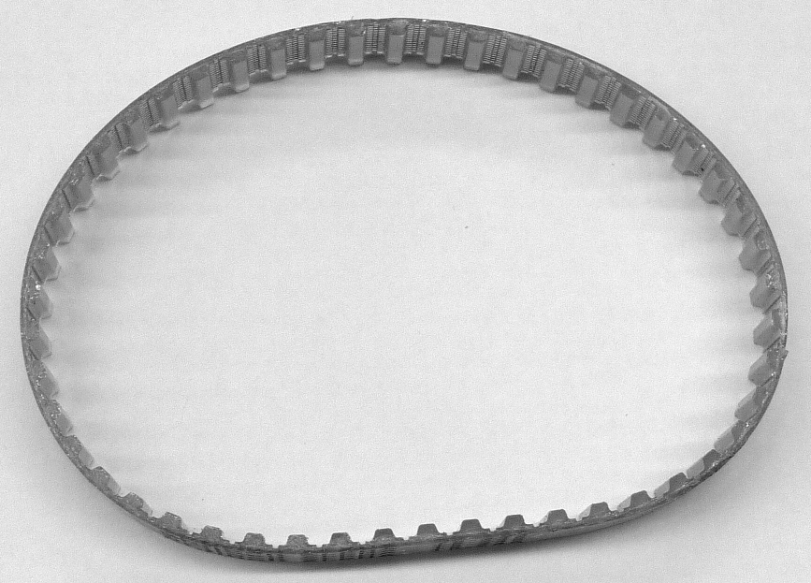
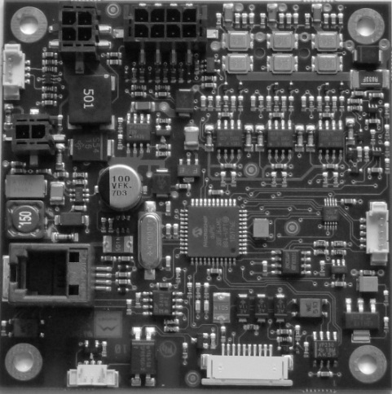
0.0040.311
0.0040.011
2.0040.900
September 2016 sh

Slide 5
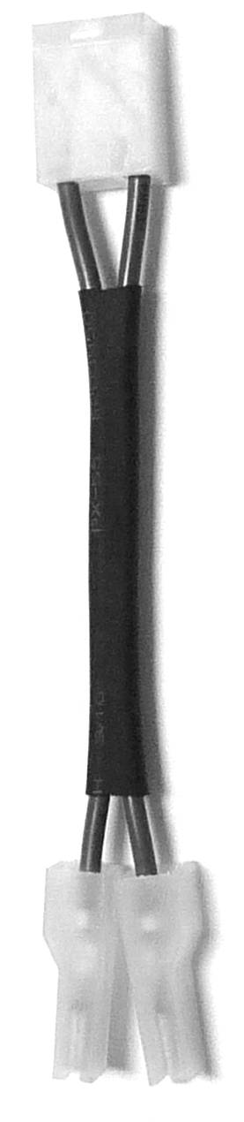
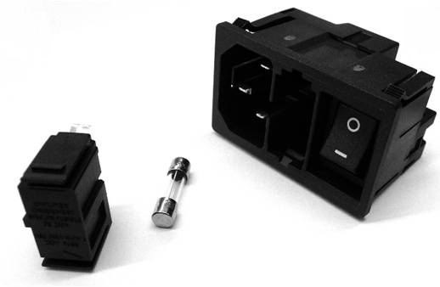
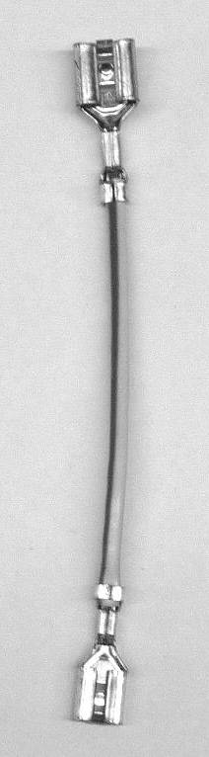
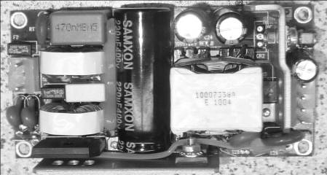
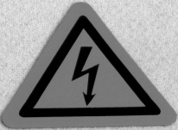
S/N 1000- 1999
0.0034.246
0.0034.245
2.0034.358
0.0040.010
0.0000.005
2.0034.359
0.0040.028
September 2016 sh

Slide 6
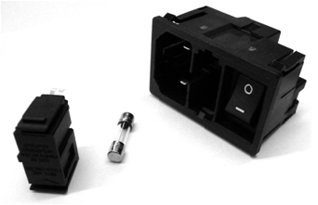
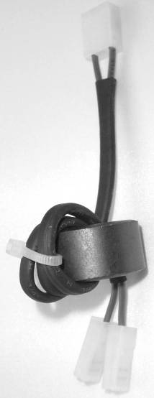
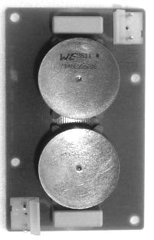
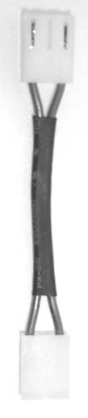
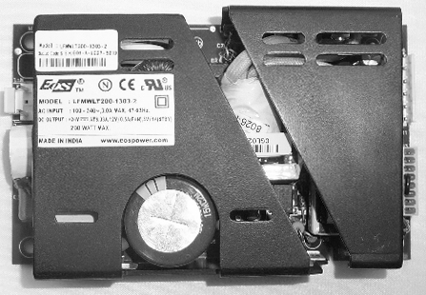
S/N 2000 - 3999
0.0034.246
0.0034.260
2.0040.904
0.0040.050
0.0000.008
2.0040.045
2.0040.044
0.0040.028
September 2016 sh

Slide 7


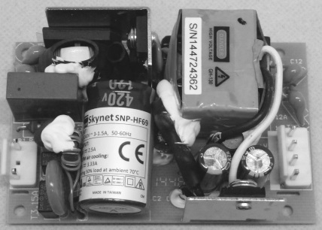
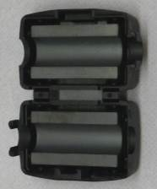
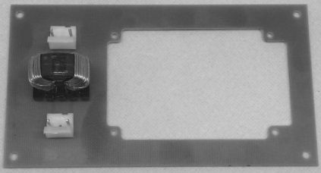
S/N > 4000
0.0034.246
0.0034.260
0.0040.058
2.0040.905
0.0040.080
0.0000.107
2.0038.033
2.0040.052
0.0040.028
September 2016 sh

Slide 8
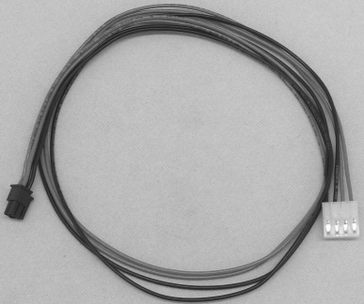
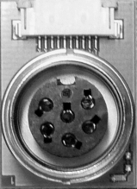
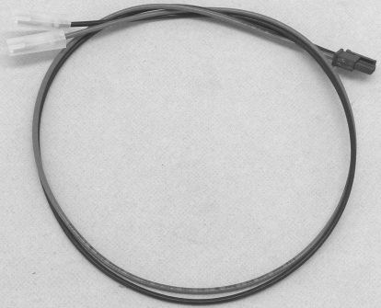
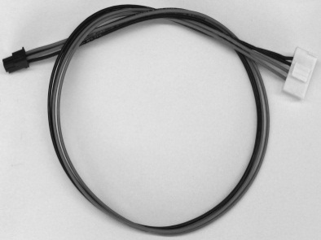
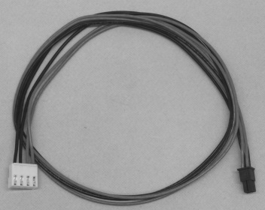
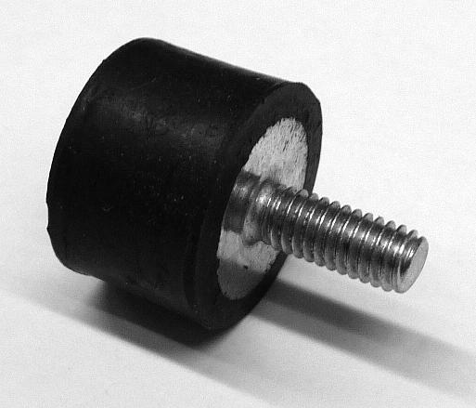
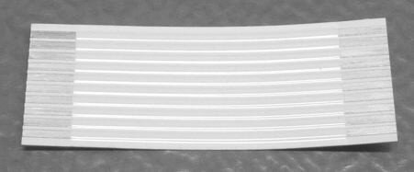
power supply wire
S/N 1000 – 1999
S/N 2000 - 3999
S/N > 4000
2.0040.901
2.0040.037
2.0040.036
2.0040.043
2.0040.051
0.0037.104
0.0040.001
September 2016 sh

Slide 9
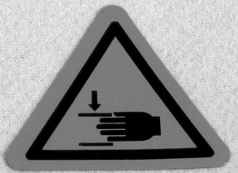
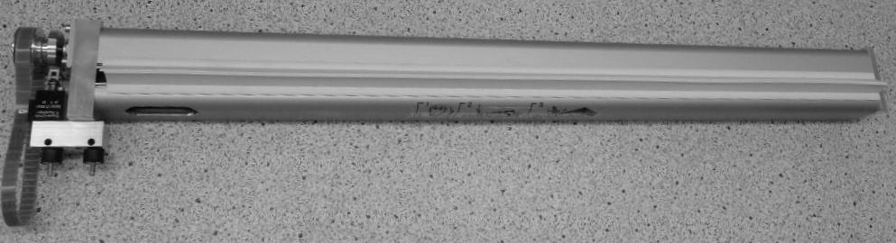


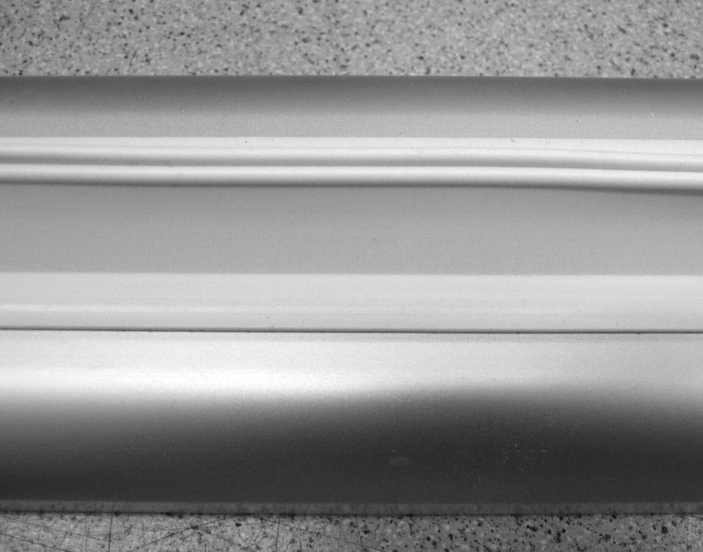
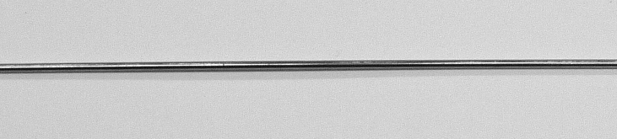
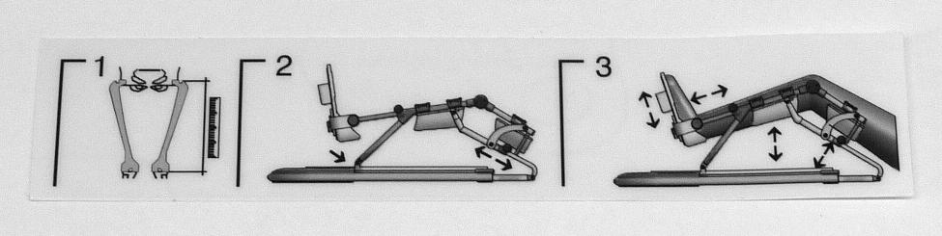
0.0040.026
0.0040.310
0.0040.025
0.0040.027
2.0037.105
0.0037.038
2.0037.241
September 2016 sh

Slide 10
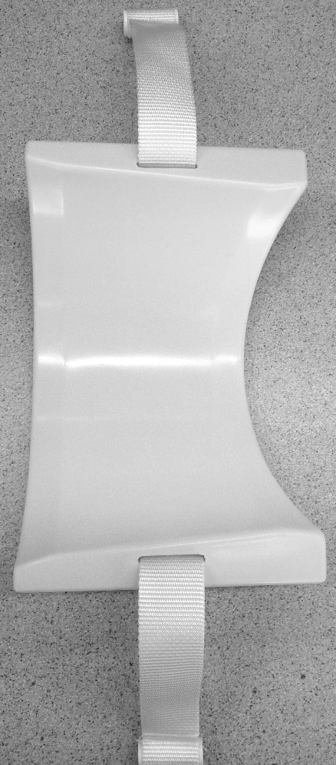
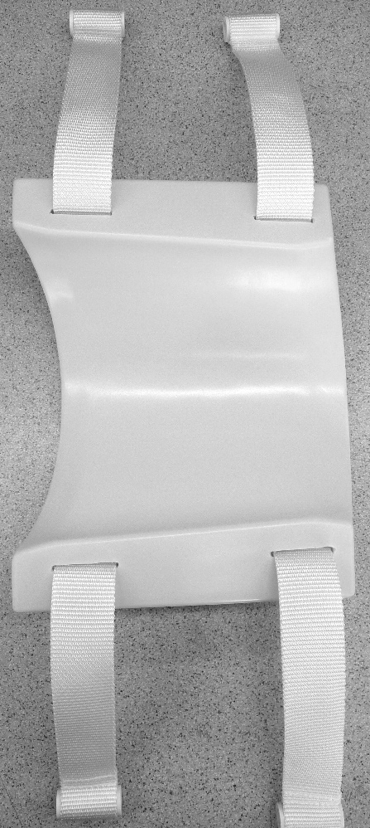
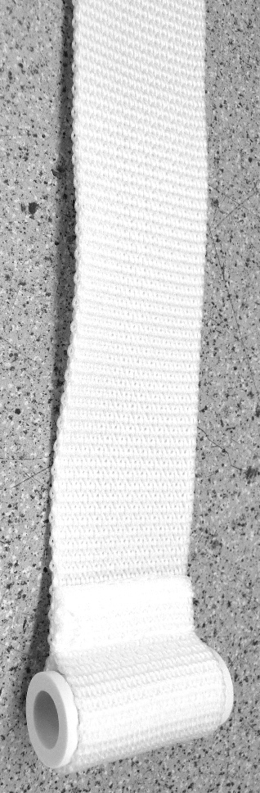
2.0013.073
2.0013.074
2.0013.059
September 2016 sh

Slide 11
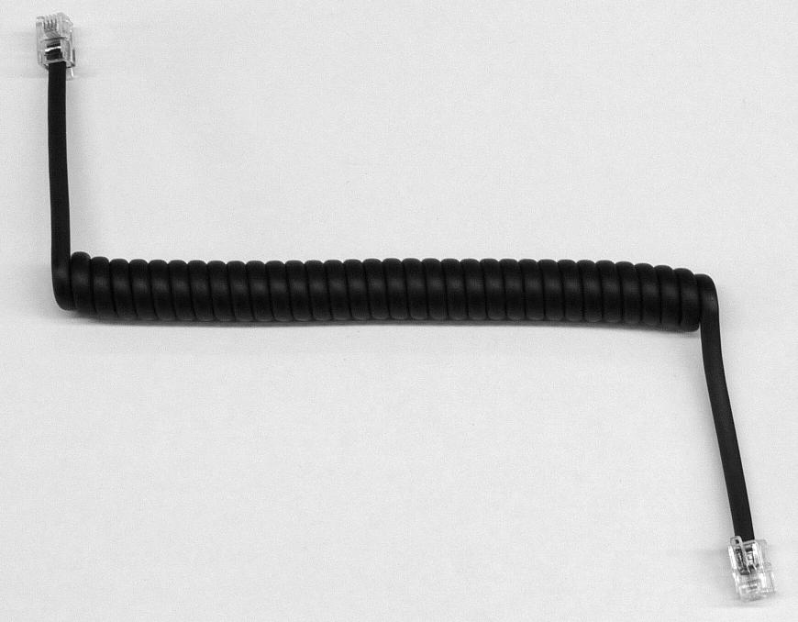
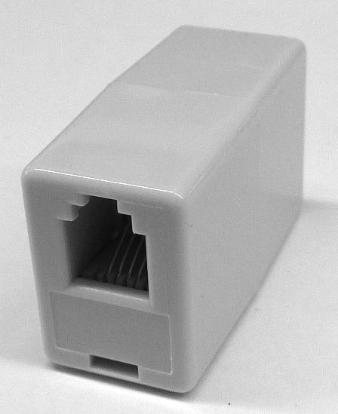
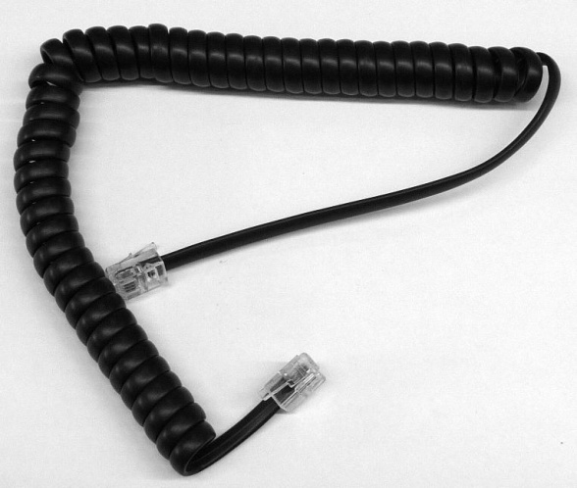
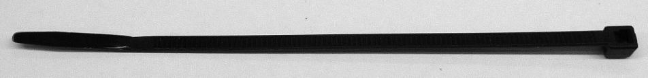
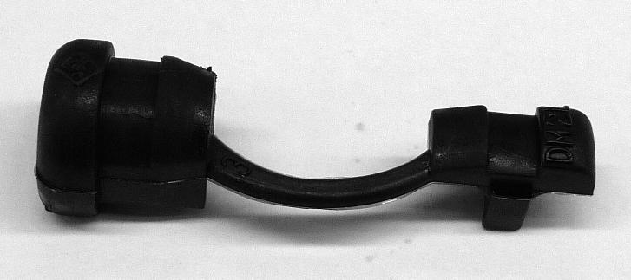
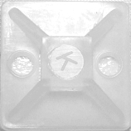
2.0037.258
0.0037.107
0.0031.122
0.0037.111
0.0037.006
0.0013.118
0.0013.001
September 2016 sh

Slide 12
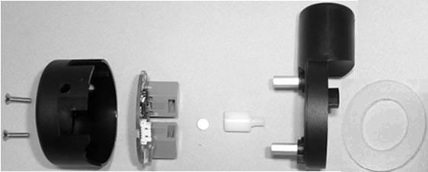
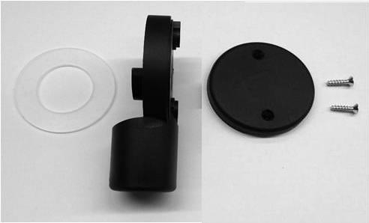
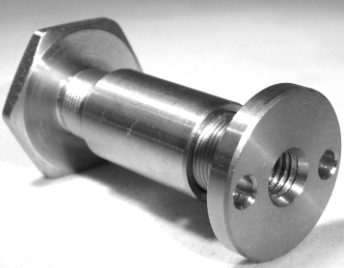
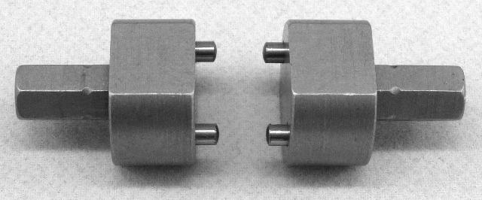
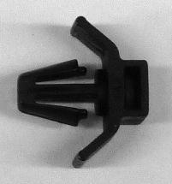
SN < 5000 2.0040.902
SN > 5000 2.0040.906
2.0040.017
2.0037.136
2.0037.151
2.0040.154
DIN7991 M3x12A2
0.0040.328
2.0037.136
2.0037.150
0.0037.022
0.0037.110
0.0040.325
0.0037.003
September 2016 sh

Slide 13
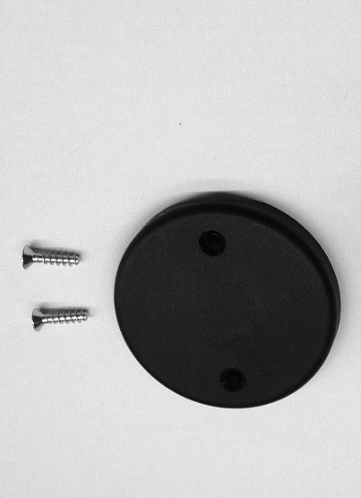




0.0037.022
2.0037.150
2.0037.150
0.0037.022
2.0037.151
2.0037.136
2.0037.136
2.0037.151
0.0037.079
0.0037.003
September 2016 sh

Slide 14











0.0040.320
0.0040.326
0.0040.327
0.0040.999
2.0040.046
2.0040.047
0.0040.324
2.0040.049
2.0040.048
0.0034.114
2.0038.118
0.0040.329
0.0029.120
September 2016 sh

Slide 15








0.0040.161
0.0040.321
2.0040.035
LIKO M3x12A2
2.0040.177
0.0040.004
0.0040.006
DIN9021 D3,2A2
LIKO M3x6A2
September 2016 sh

Slide 16




0.0037.150
2.0037.243
2.0013.314
2.0037.202
2.0038.142
0.0040.015
September 2016 sh

Slide 17


2.0040.162
2.0037.243
2.0037.203
September 2016 sh

Slide 18



0.0040.331
0.0037.017
2.0040.141
DIN7991M5x10A2
September 2016 sh

Slide 19

September 2016 sh

Slide 20





LEFT: 0.0040.322; RIGHT: 0.0040.323
2.0037.047
2.0037.173
0.0040.009
2.0037.118
DIN6799D5A2
September 2016 sh

Slide 21







2.0040.159
2.0037.009
959.026
0.0037.018
0.0040.005
0.0037.037
0.0037.025
September 2016 sh

Slide 22


0.0040.300
0.0037.103
September 2016 sh

Slide 23








2.1000.106
2.1000.109
0.0040.340
0.1000.001
2.1000.001
0.0031.004
2.1000.101
2.1000.102
September 2016 sh

Slide 24







0.0040.210
0.0040.211
0.0040.212
0.0040.213
0.0040.215
September 2016 sh

Slide 25






2.0040.119
DIN7991M8x30vz
0.0040.035
0.0040.012
0.0040.037
0.0028.108
0.0040.036
September 2016 sh

